Slide 1
Lecture 18
Shadows and Gradients

Slide 2


Introduction
PathEffect, MaskFilter, ColorFilter, Shader, and ShadowLayer are all attributes of Paint.
Anything drawn with Paint can be drawn by one or more of these transformations.
Widgets 1 and 2 demonstrate Shadows.
Widgets 3 and 4 demonstrate Gradients.

Slide 3
Shadow
Shadows are controlled by the setShadowLayer method in Java File.
We can control to shadow using Layout XML File also by using these 4 Parameters:-
1. android:shadowDx – specifies the X-axis offset of shadow. You can give -/+ values, where -Dx draws a shadow on the left of text and +Dx on the right.
2. android:shadowDy – it specifies the Y-axis offset of shadow. -Dy specifies a shadow above the text and +Dy specifies below the text.
3. android:shadowRadius – specifies how much the shadow should be blurred at the edges. Provide a small value if shadow needs to be prominent.
4. android:shadowColor – specifies the shadow color.

Slide 4
Making Shadow using XML File
<RelativeLayout
android:layout_width=“fill_parent"
android:layout_height=“fill_parent” >
<TextView
android:id="@+id/tv"
android:layout_width="wrap_content"
android:layout_height="wrap_content"
android:text="Sample TextView..."
android:textSize="30dp"
android:textStyle="bold"
android:textColor="@android:color/black"
android:shadowColor="@android:color/holo_red_dark"
android:shadowRadius="2"
android:shadowDy="-5"
/>

Slide 5
Making Shadow Example using XML File
<TextView
android:id="@+id/tv2"
android:layout_width="wrap_content"
android:layout_height="wrap_content"
android:layout_below="@id/tv"
android:text="Sample TextView..."
android:textSize="30dp"
android:textStyle="bold"
android:textColor="@android:color/black"
android:shadowColor="@android:color/holo_red_dark"
android:shadowRadius="2"
android:shadowDy="5"
/>

Slide 6
Making Shadow Example using XML File
<TextView
android:id="@+id/tv3"
android:layout_width="wrap_content"
android:layout_height="wrap_content"
android:layout_below="@id/tv2"
android:text="Sample TextView..."
android:textSize="30dp"
android:textStyle="bold"
android:textColor="@android:color/black"
android:shadowColor="@android:color/holo_red_dark"
android:shadowRadius="2"
android:shadowDx="-5"
/>

Slide 7
Making Shadow Example using XML File
<TextView
android:id="@+id/tv4"
android:layout_width="wrap_content"
android:layout_height="wrap_content"
android:layout_below="@id/tv3"
android:text="Sample TextView..."
android:textSize="30dp"
android:textStyle="bold"
android:textColor="@android:color/black"
android:shadowColor="@android:color/holo_red_dark"
android:shadowRadius="2"
android:shadowDx="5"
/>

Slide 8
Making Shadow Example using XML File
<TextView
android:id="@+id/tv5"
android:layout_width="wrap_content"
android:layout_height="wrap_content"
android:layout_below="@id/tv4"
android:text="Sample TextView..."
android:textSize="30dp"
android:textStyle="bold"
android:textColor="@android:color/black"
android:shadowColor="@android:color/holo_red_dark"
android:shadowRadius="2"
android:shadowDy="5"
android:shadowDx="5”
/>

Slide 9
Making Shadow Example using XML File
<TextView
android:id="@+id/tv6"
android:layout_width="wrap_content"
android:layout_height="wrap_content"
android:layout_below="@id/tv5"
android:text="Sample TextView..."
android:textSize="30dp"
android:textStyle="bold"
android:textColor="@android:color/black"
android:shadowColor="@android:color/holo_red_dark"
android:shadowRadius="2"
android:shadowDy="-5"
android:shadowDx="-5"
/>
</RelativeLayout>

Slide 10
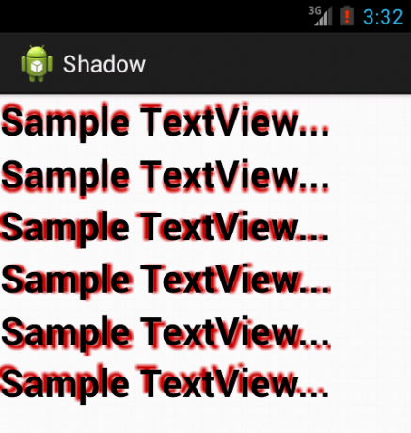
Output

Slide 11
Gradient Example
Take a new Project by name GradientApp.
It will provide you a XML File “activity_main.xml” and a Java file “MainActivity.java”.
Now, Firstly make a folder name “drawable” in res folder.
Press right click on drawable folder and take Android XML file by any name like: “drawable_gradient”.
This xml file will be use to write Gradient code.

Slide 12
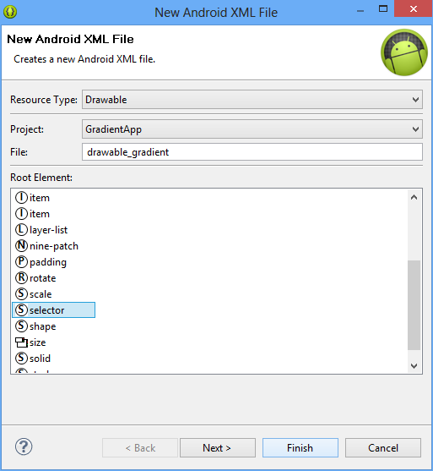
Gradient Example

Slide 13
Code of drawable_gradient.xml file
<?xml version="1.0" encoding="utf-8"?>
<selector xmlns:android="http://schemas.android.com/apk/res/android" >
<item>
<shape>
<gradient
android:startColor="@android:color/holo_blue_dark"
android:centerColor="@android:color/white"
android:endColor="@android:color/holo_red_dark"
android:angle=“0" />
</shape>
</item>
</selector>

Slide 14
Code of activity_main.xml file
Firstly take a button in XML File.
Now put this line into button source code for adding gradient feature with this button.
android:background="@drawable/gradient_drawable“
Folder Name
Gradient File Name

Slide 15
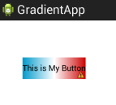
Output:- If Gradient angle is 0 or 360

Slide 16

Output:- If Gradient angle is 90

Slide 17

Output:- If Gradient angle is 180

Slide 18

Output:- If Gradient angle is 270

